Slide 1
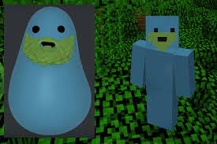
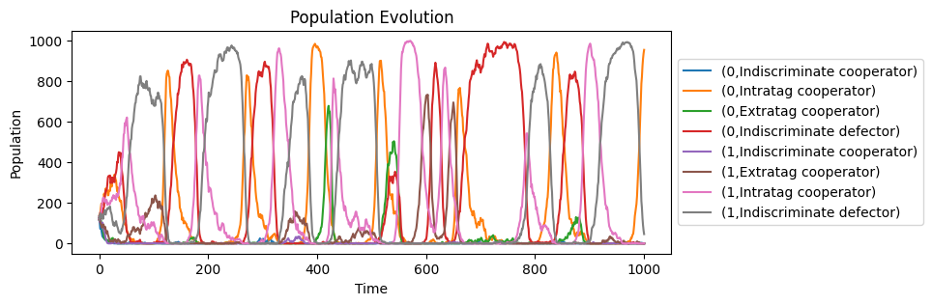
Stochastic Modelling Project
By Miguel Pinel Martínez

Slide 2
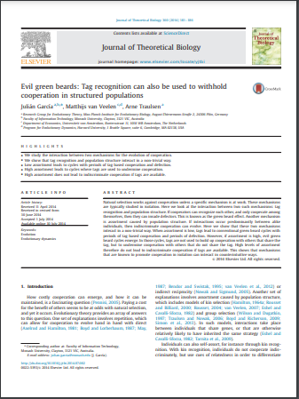
Evil green beards: Tag recognition can also be used to withhold cooperation in structured population
Authors of the paper:
Julián García
Matthijs van Veelen
Arne Traulsen
This project has been made with the help of Matthijs van Veelen who has had no problem explaining in detail the particularities of these models

Slide 3

Is altruism evolutionarily viable?
One of the most interesting biological question is: “Is altruism viable following Darwinian evolution?”.
If the evolution is the survival of the fittest, can an individual with a altruistic behaviour survive?
Understanding in this context altruism as helping another member of the population by doing something inherently negative for yourself
For more information recommended literature

Slide 4



Prisioner's dilemma
We are going to simulate interactions between individuals folllowing a standard prisioner's dilemma.
As it is usual both cooperating give the best overall outcome but is an inestable state, being both defectors is the Nash equilibrium even though is overall worst.

Slide 5
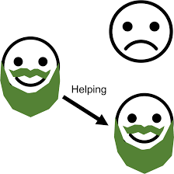
Green beard effect
It would be beneficial for the cooperators to have a way of distinguish other cooperators from defectors.
This is the green beards effect, all the individuals that have the strategy of cooperate also have a distinguish factor, like a green beard, so that all the green beards will cooperate with each others, but not with the rest.

Slide 6
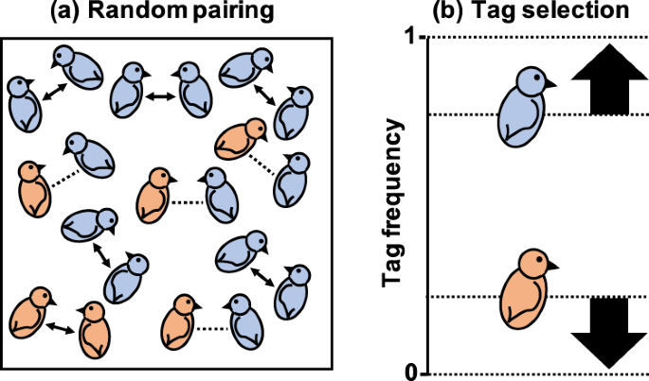
Tags recognition
In this project each individual will have a tag that represent a way for the rest of the population to know to which group it belongs. We are going to focus on only two different tags, but the results are generalizable to k tags.
Each individual will be represented as a tag(0 or 1) and the strategies it follow against each of the tags, for example [0,(C,C)] will be an indiscriminate cooperator of tag 0

Slide 7

Assortment cause by population structure
The main different from this paper to previous about the green beard effect is the population structure.
In this context we understand the population structure as the increase in the probability of encountering an individual with your same strategy.
Our focus will be to find the predominant strategy depending of the level of population structure

Slide 8
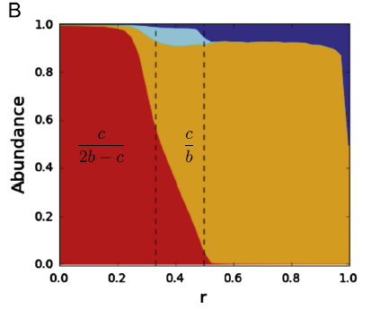
Results of the paper :
This is the main result of the paper that we will try to replicate.
Base on the level of assortment there are three main scenarios: if the level is very low the indiscriminate defector is the best strategy, as the level increase the intra-tag cooperator become the dominant strategy and start the usual green beard cycles, lastly if the level is too high then they start the evil green beard cycles

Slide 9
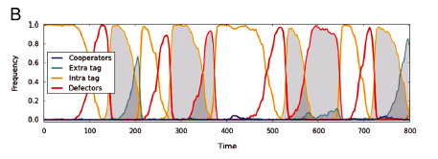
Normal green beard cycle
The normal green beard cycle is as follow: it start with a high number of cooperators of one tag, they get invaded by false green beards, defectors of the same tag, when there are a lot of defectors in that tag then the best strategy is to be an intra-tag cooperator of the other tag, therefore starting again the cycle
Indiscriminate defector of tag A
Intra-tag
cooperator of tag A
Intra-tag
cooperator of tag B

Slide 10
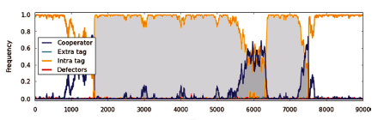
Evil green beard cycle
The evil green beard cycle is as follow: it start with a high number of intra-tag cooperators of one tag, they drift into a mix with indiscriminate cooperators, when there are enough indiscriminate cooperators in that tag then the best strategy is to be an intra-tag cooperator of the other tag, therefore starting again the cycle.
Indiscriminate cooperators of tag A
Intra-tag
cooperator of tag A
Intra-tag
cooperator of tag B

Slide 11
The model:
Moran Process
Fitness calculation
Parents selection
Random Mutation
We choose the parents for the next generation randomly with probabilities proportional of the fitness of each individual
We change a small percentage of the population to a random strategy
First we calculate the fitness advantages of each individual

Slide 12
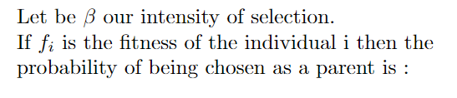
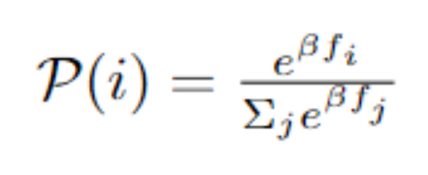
Intensity of selection
The intensity of selection is a parameter that determine how strongly does the different in fitness affects the parents selection.

Slide 13

Exogenous assortment:
Parameter r
We are going to consider a level of structure in the population, reflected in the parameter r which is going to represent the extra probability of an individual to play against the same strategy as itself

Slide 14
Exogenous assortment:
Parameter r (2)
Old Generation
New Generation
1
2
P1
X1
X1
Probability r of being equal
P2
X2
3
P3
Copy one of the parents wih probability Pi
X3
Thefitness will be calculated only in pairs
P4
X4
P5
X5
Vector of the probabilities of being a parent
Vector of the probabilities of being a parent
Vector of the new individuals

Slide 15
Results of the simulations:
Parameters
The model used has been created using Google Colab in python using the following parameters:
Population size: 1000
Mutation chance: 0.001
Intensity of selection: 0.5
The main different with the simulations of the paper is that our number of generations is quite lower from the one million used in the original paper.

Slide 16
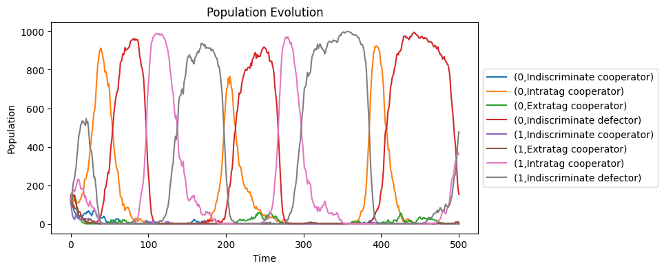
Results of the simulations:
Normal green beard cycle
Simulation of 500 generations with r = 0.4

Slide 17
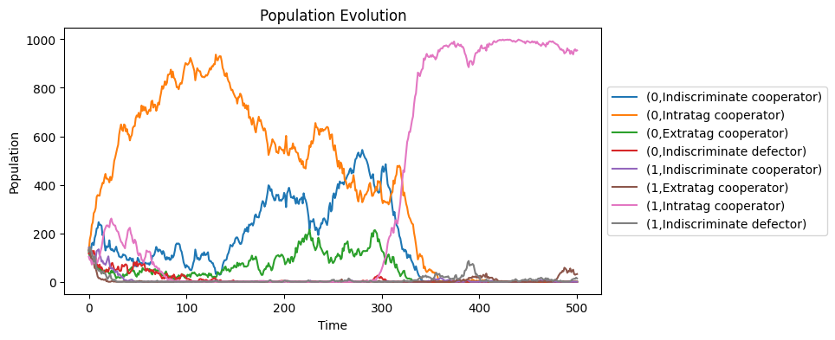
Results of the simulations:
Evil green beard cycle (1)
Simulation of 500 generations with r = 0.6

Slide 18
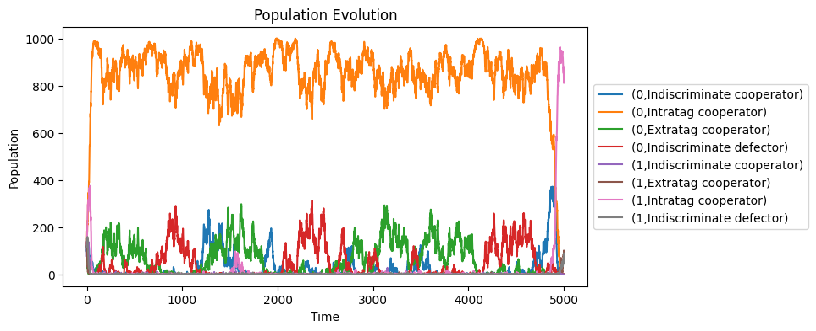
Results of the simulations:
Evil green beard cycle (2)
The evil green beard cycle can be have long period of time without changing tag
Simulation of 5000 generations with r = 0.6

Slide 19
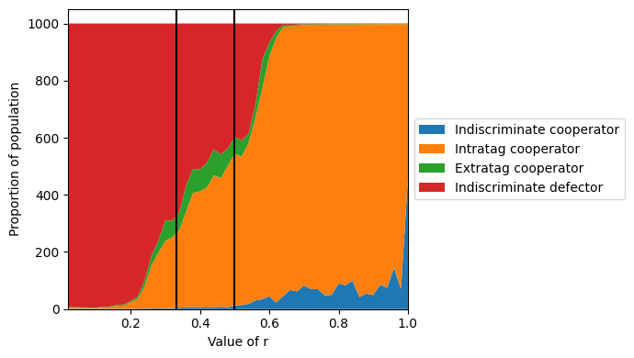

Results of the simulations:
Strategies depending of r (1)
100 simulations of 10000 generations each varying r
With intensity of selection being 0.5

Slide 20
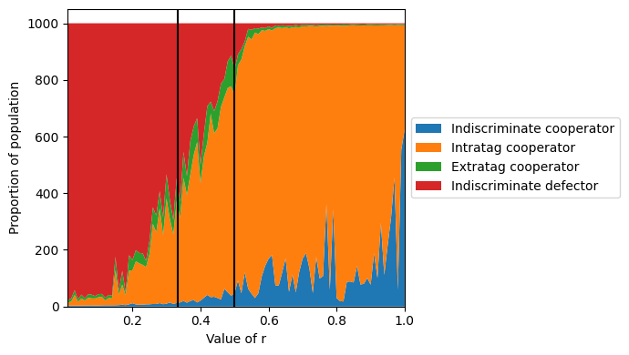
Results of the simulations:
Strategies depending of r (2)
With intensity of selection being 0.1

Slide 21
Conclusions
The results of the paper seems plausible because they coincide with the results of our simulations.
With high population structure cooperation is viable, but indiscriminate cooperation is never the best strategy.
At any assorment level we can find changes in which tag is the predominant one.

